Slide 1


Slide 2
Artificial Intelligence (CS-401) Lecture 8: Probability and Uncertainty
Dr. Fahad Sherwani (Assistant Professor – FAST NUCES)
PhD in Artificial Intelligence
Universiti Tun Hussein Onn Malaysia
fahad.sherwani@nu.edu.pk

Slide 3
Using Uncertainty Knowledge
Agents don’t have complete knowledge about the world. Agents need to make decisions based on their uncertainty. It isn’t enough to assume what the world is like.
Example: Autonomous Robot
An agent needs to reason about its uncertainty.
Artificial Intelligence , Page 3

Slide 4
Why Probability?
There is lots of uncertainty about the world, but agents still need to act.
Predictions are needed to decide what to do:
⁾ definitive predictions: There will be a class tomorrow
⁾ point probabilities: probability of having a class tomorrow is 0.002
⁾ probability ranges: The class will be held tomorrow with probability in range [0.001,0.34]
Acting is gambling: agents who don’t use probabilities will lose to those who do.
Probabilities can be learned from data.
Bayes’ rule specifies how to combine data and prior knowledge.
Artificial Intelligence , Page 4

Slide 5
Probability
Probability is an agent’s measure of belief in some proposition — subjective probability.
An agent’s belief depends on its prior assumptions and what the agent observes.
Artificial Intelligence , Page 5

Slide 6
Numerical Measures of Belief
Belief in proposition, f , can be measured in terms of a number between 0 and 1 — this is the probability of f .
⁾ The probability f is 0 means that f is believed to be definitely false.
⁾ The probability f is 1 means that f is believed to be definitely true.
Using 0 and 1 is purely a convention.
f has a probability between 0 and 1, means the agent is ignorant of its truth value.
Probability is a measure of an agent’s ignorance. Probability is not a measure of degree of truth.
Artificial Intelligence , Page 6

Slide 7
Random Variables
A random variableis a term in a language that can take one of a number of different values.
The rangeof a variable X , written range (X ), is the set of values X can take.
A tuple of random variables (X₁, . . . , X_{n}) is a complex random variable with range range(X₁) × · · · × range(X_{n}). Often the tuple is written as X₁, . . . , X_{n}.
Assignment X = x means variable X has value x .
A proposition is a Boolean formula made from assignments of values to variables.

Slide 8
Possible World Semantics
A possible world specifies an assignment of one value to each random variable.
A random variable is a function from possible worlds into the range of the random variable.
ω |= X = x
means variable X is assigned value x in world ω.
Logical connectives have their standard meaning:
ω |= α ∧ β if ω |= α and ω |= β
ω |= α ∨ β if ω |= α or ω |= β

Slide 9
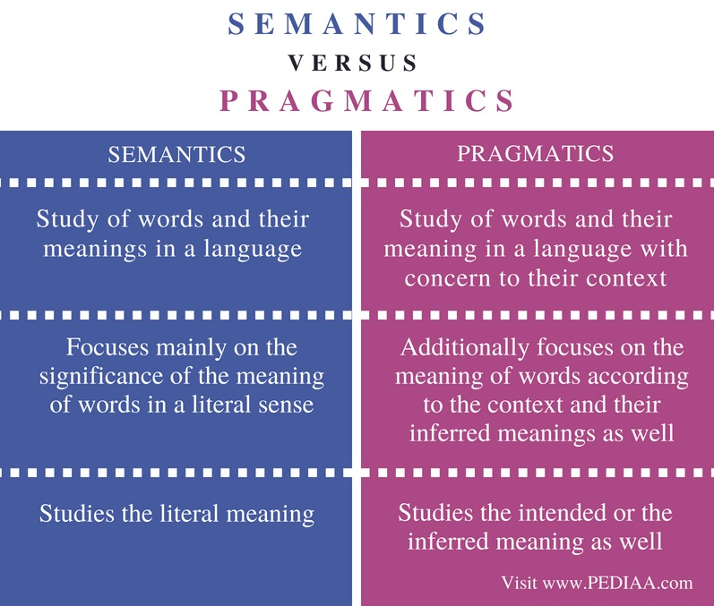
Possible World Semantics

Slide 10
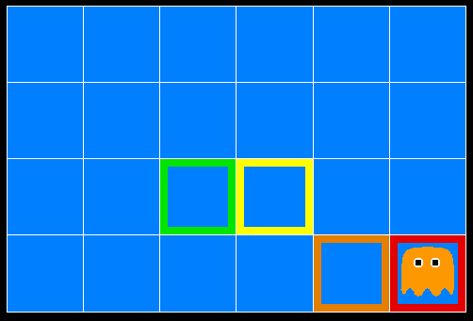
Inference in Ghostbusters
A ghost is in the grid somewhere
Sensor readings tell how close a square is to the ghost
On the ghost: red
1 or 2 away: orange
3 or 4 away: yellow
5+ away: green
Sensors are noisy, but we know P(Color | Distance)
P(red | 3) | P(orange | 3) | P(yellow | 3) | P(green | 3)
0.05 | 0.15 | 0.5 | 0.3

Slide 11

Video of Demo Ghostbuster – No probability

Slide 12
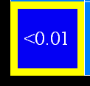
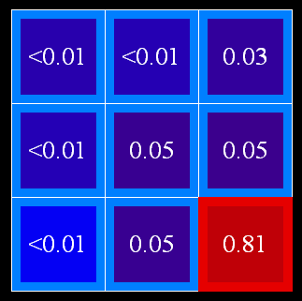

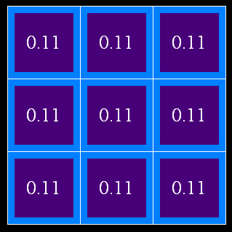
Uncertainty
General situation:
Observed variables (evidence): Agent knows certain things about the state of the world (e.g., sensor readings or symptoms)
Unobserved variables: Agent needs to reason about other aspects (e.g. where an object is or what disease is present)
Model: Agent knows something about how the known variables relate to the unknown variables
Probabilistic reasoning gives us a framework for managing our beliefs and knowledge

Slide 13

Random Variables
A random variable is some aspect of the world about which we (may) have uncertainty
R = Is it raining?
T = Is it hot or cold?
D = How long will it take to drive to work?
L = Where is the ghost?
We denote random variables with capital letters
Like variables in a CSP, random variables have domains
R in {true, false} (often write as {+r, -r})
T in {hot, cold}
D in [0, ∞)
L in possible locations, maybe {(0,0), (0,1), …}

Slide 14
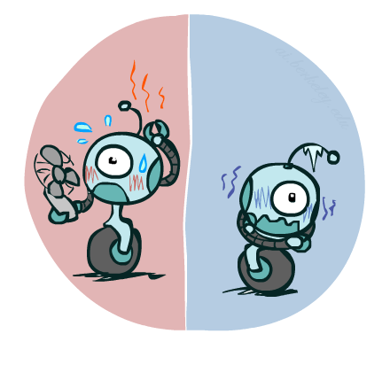

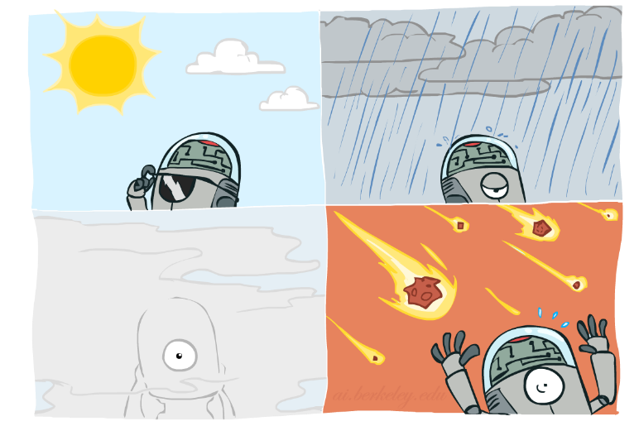

Probability Distributions
Associate a probability with each value
Temperature:
Weather:
W | P
sun | 0.6
rain | 0.1
fog | 0.3
meteor | 0.0
T | P
hot | 0.5
cold | 0.5

Slide 15


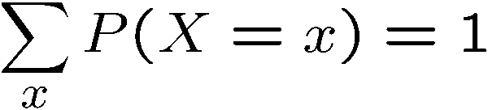
Probability Distributions
Unobserved random variables have distributions
A distribution is a TABLE of probabilities of values
A probability (lower case value) is a single number
Must have: and
Shorthand notation:
OK if all domain entries are unique
T | P
hot | 0.5
cold | 0.5
W | P
sun | 0.6
rain | 0.1
fog | 0.3
meteor | 0.0

